Slide 1


Value Types and Reference Types

Slide 2
Value Types and Reference Types
Some data types are value types and some are reference types
Value Types | Reference Types
bool | string
int | arrays (even if their elements are value types)
long | class
char
float
double

Slide 3
What’s the difference
Variables of reference types store references to their data (objects), while variables of value types directly contain their data. With reference types, two variables can reference the same object; therefore, operations on one variable can affect the object referenced by the other variable. With value types, each variable has its own copy of the data, and it's not possible for operations on one variable to affect the other.

Slide 4

What’s the difference
Variables of reference types store references to their data (objects), while variables of value types directly contain their data. With reference types, two variables can reference the same object; therefore, operations on one variable can affect the object referenced by the other variable. With value types, each variable has its own copy of the data, and it's not possible for operations on one variable to affect the other.
Notes:
Make physical example with the box etc
Code example

Slide 5
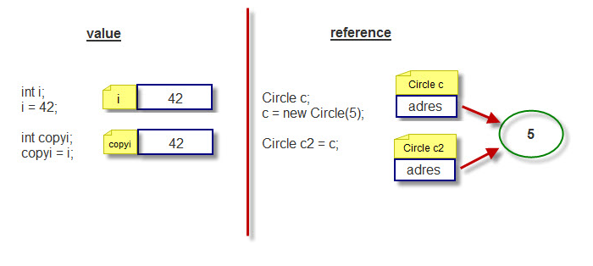
What’s the difference
Simplest way of putting it (not exactly what happens but it will do):
- Value type: when passing a value type a “copy” is made
- Reference type: when passing a reference type the actual reference is used
Notes:
Make physical example with the box etc
Code example

Slide 6
Value Types and Reference Types
EXAMPLE
Notes:
Make physical example with the box etc
Code example

Slide 7
What is the value of these variables
int age;
string name;
Notes:
Make physical example with the box etc
Code example

Slide 8
What is the value of these variables
age is 0
name is null → NULL means you are pointing at nothing
Notes:
Make physical example with the box etc
Code example

